Slide 1
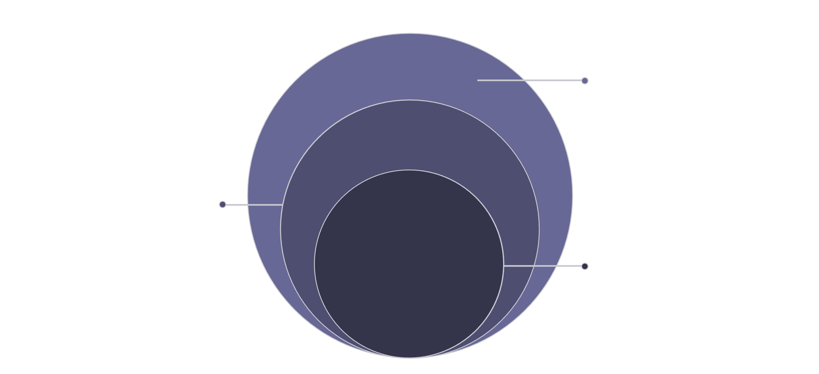
Technology Stack
Edge & Infra
WhatsApp/Mobile/Web, microservices, Vercel, payments
Real-Time Engine
Availability matching, vendor scoring, behavioral analytics
Core AI
Mastra, PipeKat, Sarvam LLMs for recommendations
Multi-LLM AI core · Real-time availability engine · Cloud-native microservices · WhatsApp-first consumer interface.

